Slide 1
Dynamic Programming Problems UNIT V
https://takeuforward.org/data-structure/dynamic-programming-introduction/

Slide 2
Index
Binomial coefficient
Box Stacking
Integer Knapsack Problem (Duplicate Items Forbidden)
Edit Distance
Longest Increasing Subsequence(LIS)
Longest Common Subsequence (LCS)
Balanced Partition Problem

Slide 3
Introduction to Dynamic Programming (DP)
Definition: Dynamic Programming (DP) is a method for solving complex problems by breaking them down into simpler overlapping subproblems, storing their results to avoid redundant work.
Key Ideas:
Overlapping Subproblems: DP reuses solutions to the same subproblems multiple times.
Optimal Substructure: The solution to the problem can be built from the solutions of smaller subproblems.

Slide 4
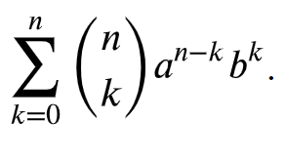
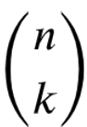
What is the Binomial Theorem?
The binomial theorem is an algebraic method for expanding any binomial of the form (a+b)^{n} without the need to expand all n brackets individually. The binomial theorem formula states that
A binomial contains exactly two terms. These 2 terms must be constant terms (numbers on their own) or powers of 𝑥 (or any other variable).
Mathematically, ^{n}C_{r} = = n!/r!* (n-r)!
https://mathsathome.com/the-binomial-expansion/

Slide 5
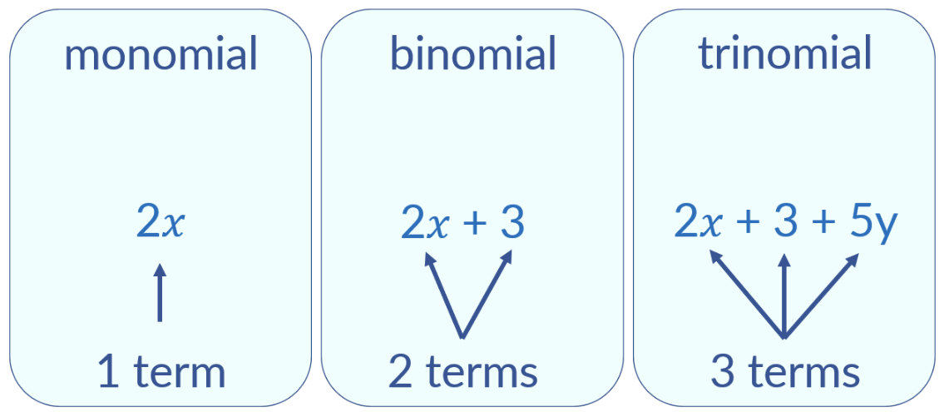
A binomial can be raised to a power such as (2𝑥+3)⁵, which means (2𝑥+3)(2𝑥+3)(2𝑥+3)(2𝑥+3)(2𝑥 +3).
However, expanding this many brackets is a slow process and the larger the power that the binomial is raised to, the easier it is to use the binomial theorem instead.

Slide 6
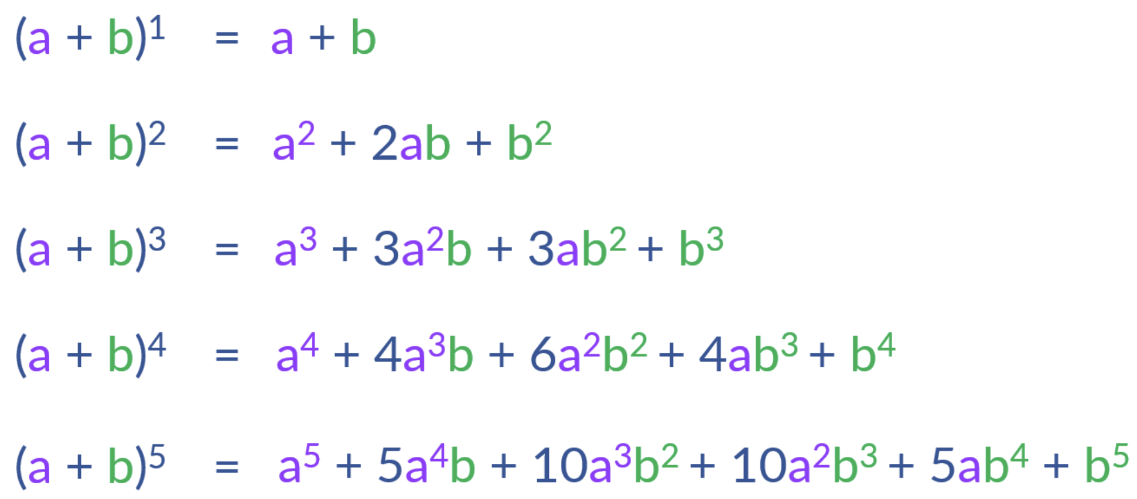
Binomial Expension

Slide 7
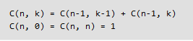
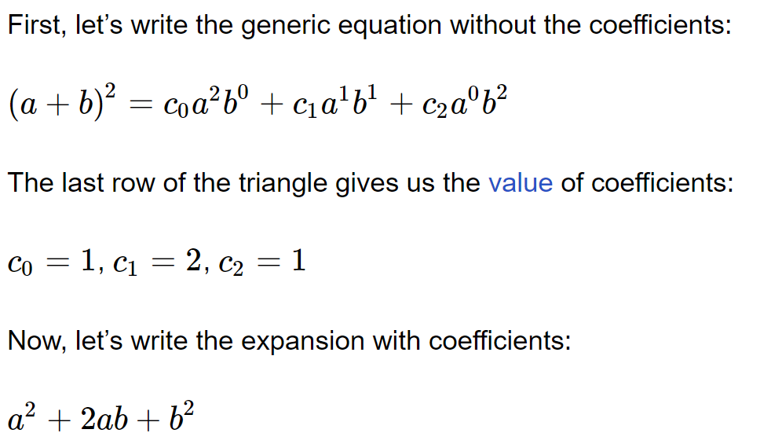
Pascal’s Triangle is a triangular array of the binomial coefficients.
1
1 1
1 2 1
1 3 3 1
1 4 6 4 1
1 5 10 10 5 1
https://practice.geeksforgeeks.org/problems/pascal-triangle0652/1

Slide 8
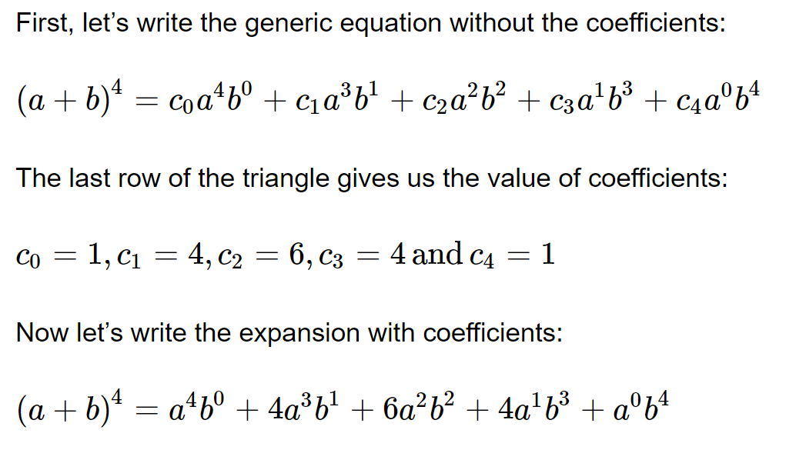

Slide 9
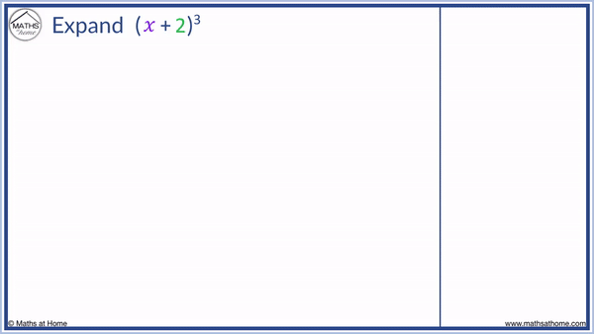

Slide 10

5.2: Box Stacking
You are given a set of n types of rectangular 3-D boxes, where the i ^{th} box has height h(i), width w(i) and depth d(i) (all real numbers).
You want to create a stack of boxes which is as tall as possible, but you can only stack a box on top of another box if the dimensions of the 2-D base of the lower box are each strictly larger than those of the 2-D base of the higher box.
Of course, you can rotate a box so that any side functions as its base. It is also allowable to use multiple instances of the same type of box.
https://people.computing.clemson.edu/~bcdean/dp_practice/
https://iq.opengenus.org/box-stacking-problem/

Slide 11
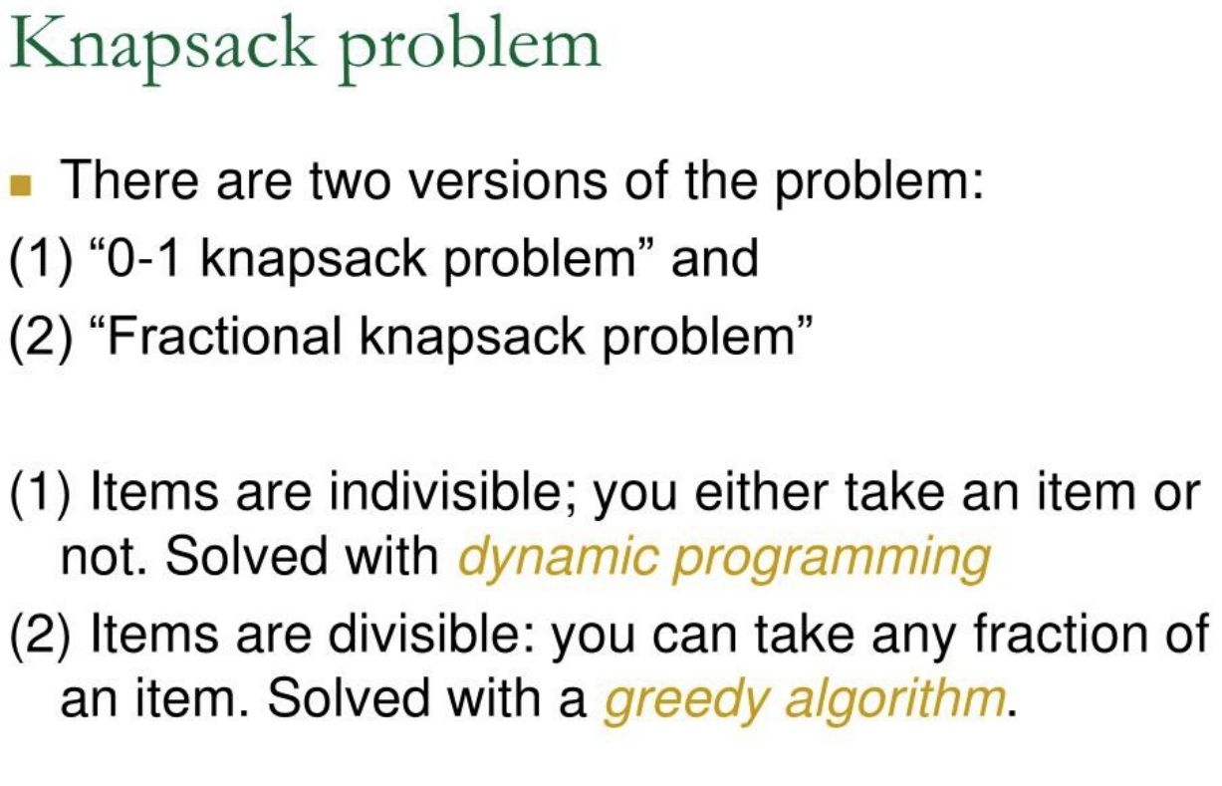

Slide 12
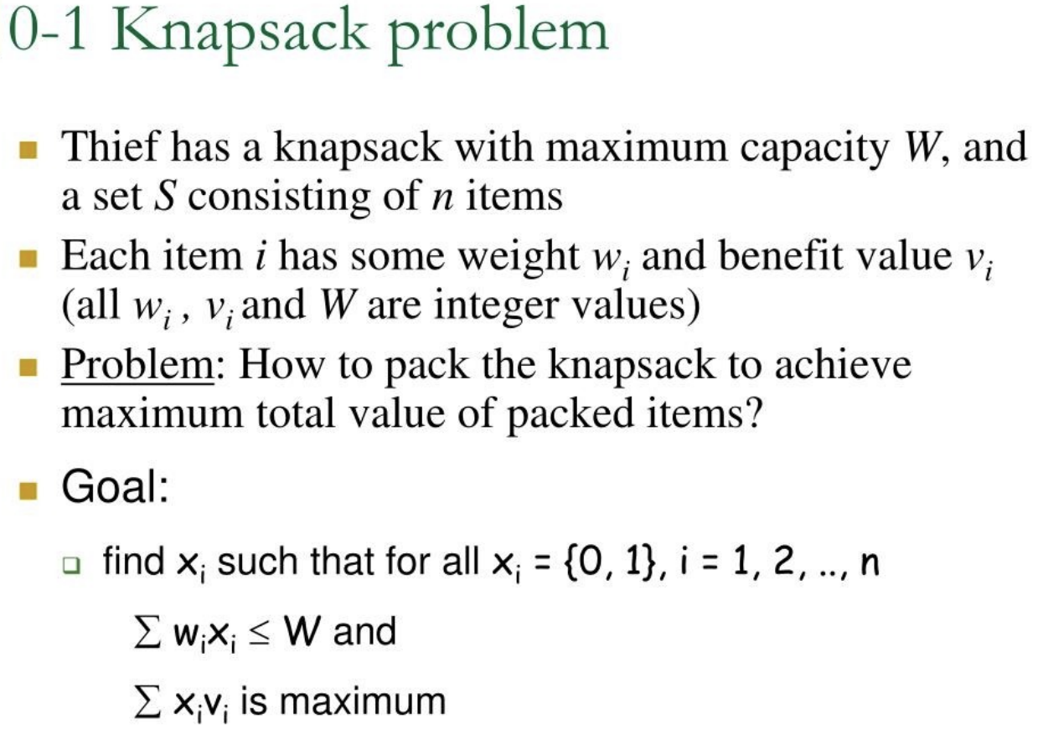

Slide 13
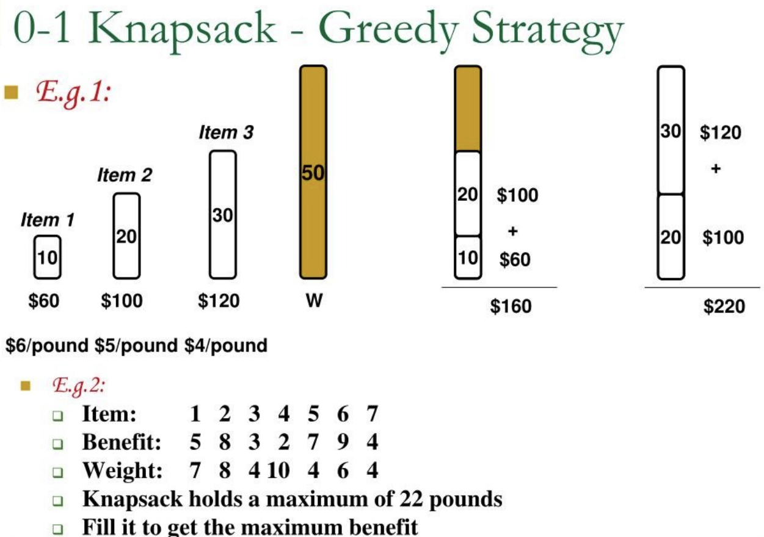

Slide 14
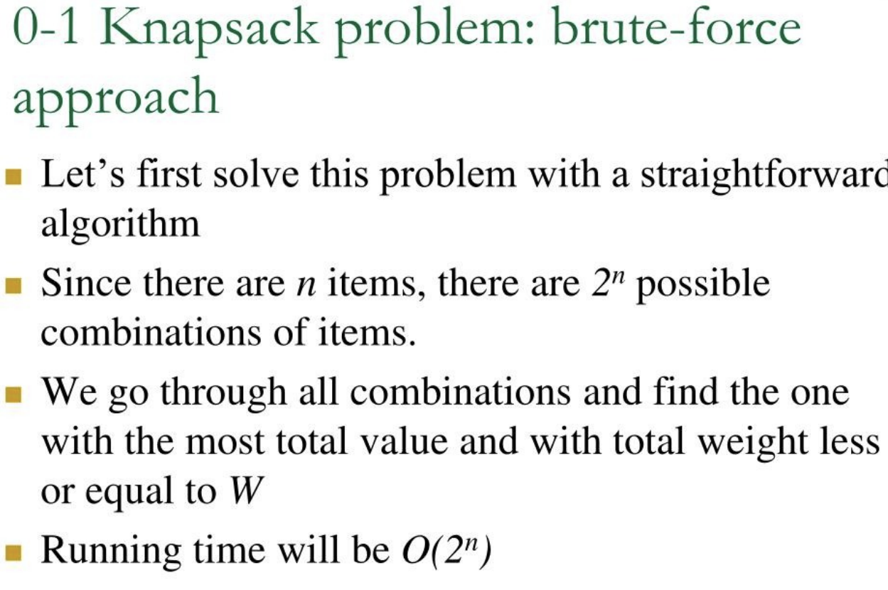
For n 2^n possible subsets.
Since there are nnn elements in the set and each element has 2 choices (include or exclude),

Slide 15
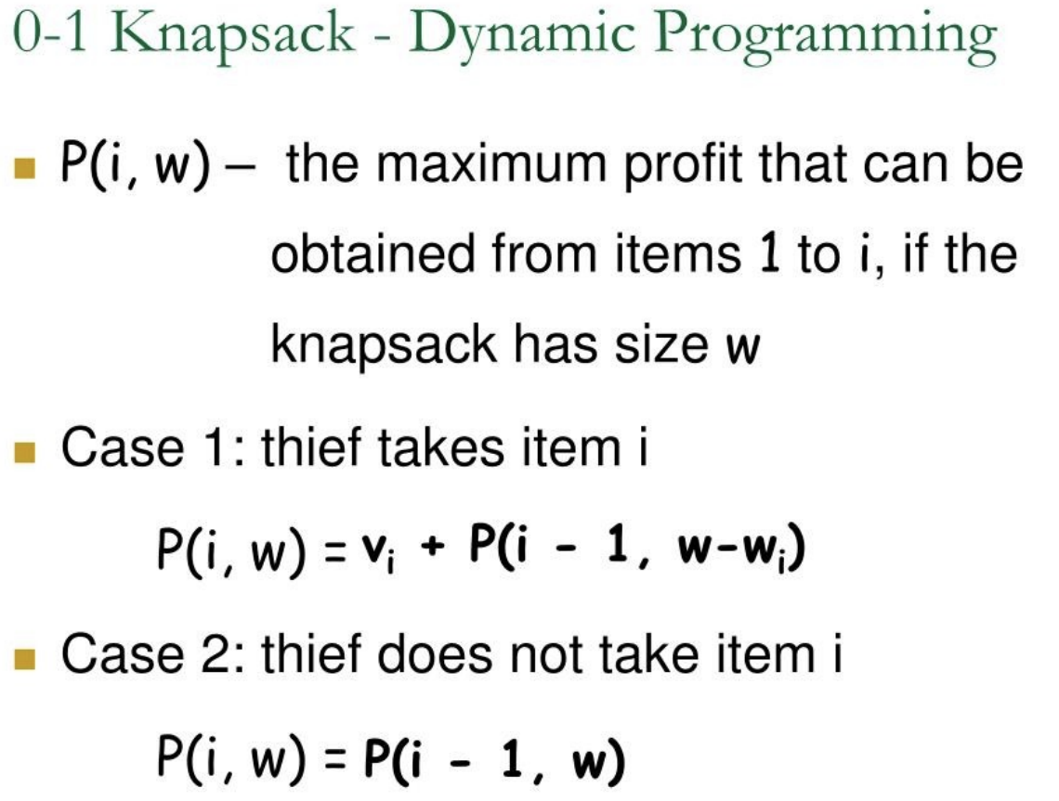

Slide 16
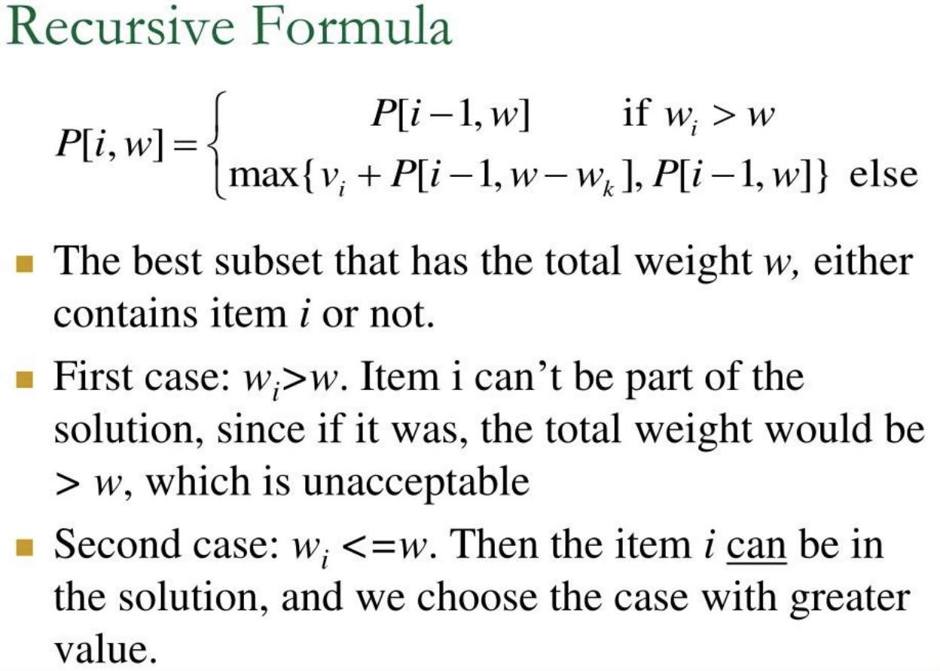

Slide 17
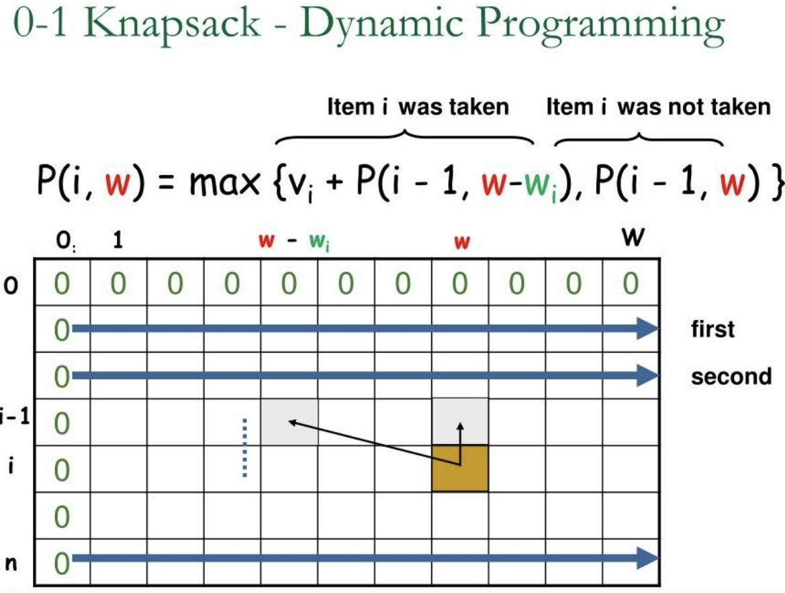

Slide 18
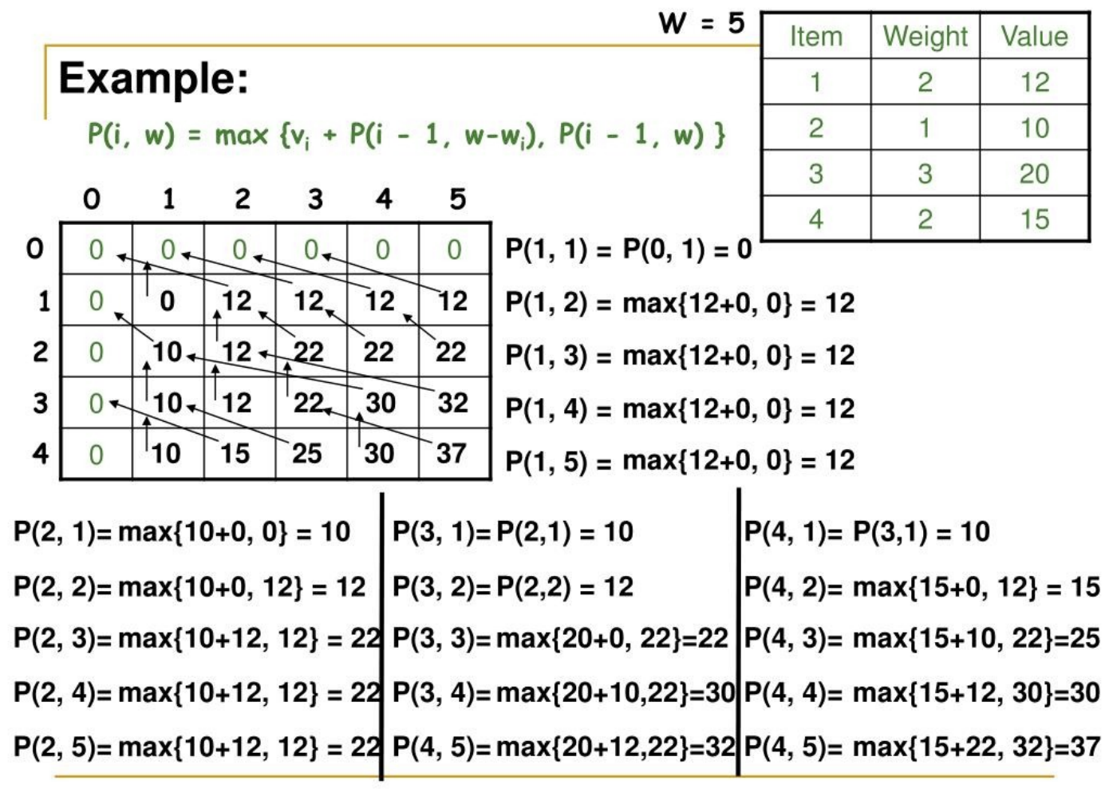

Slide 19
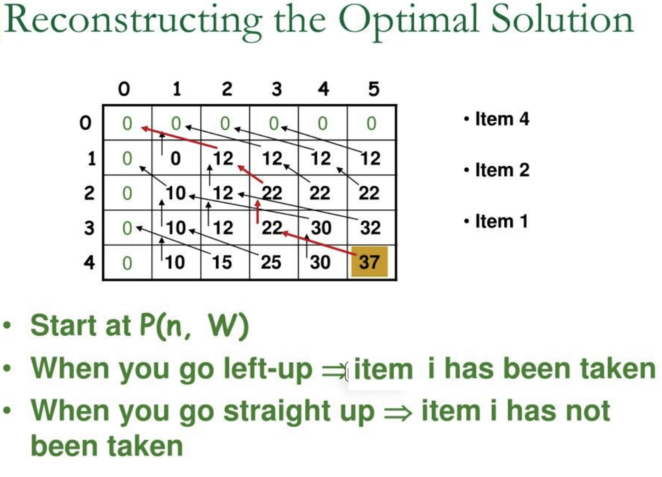
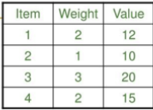

Slide 20
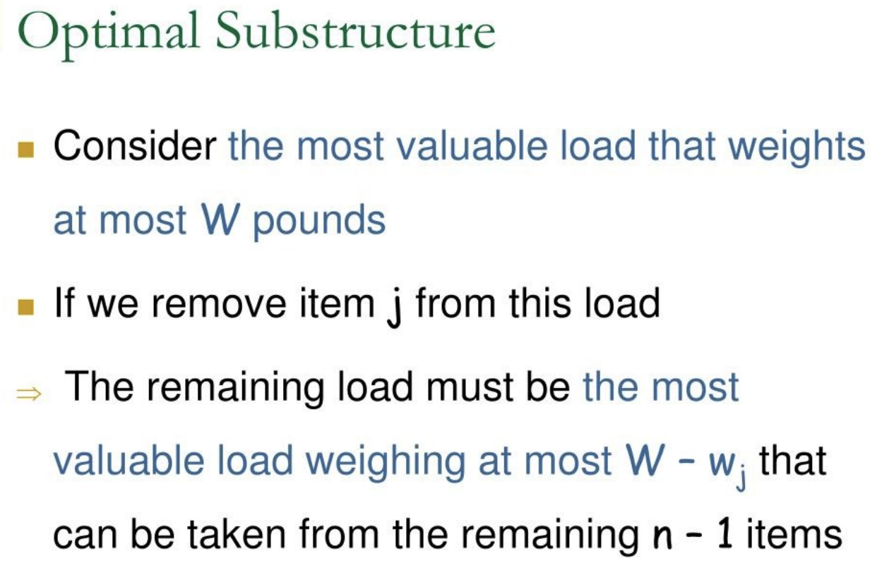

Slide 21
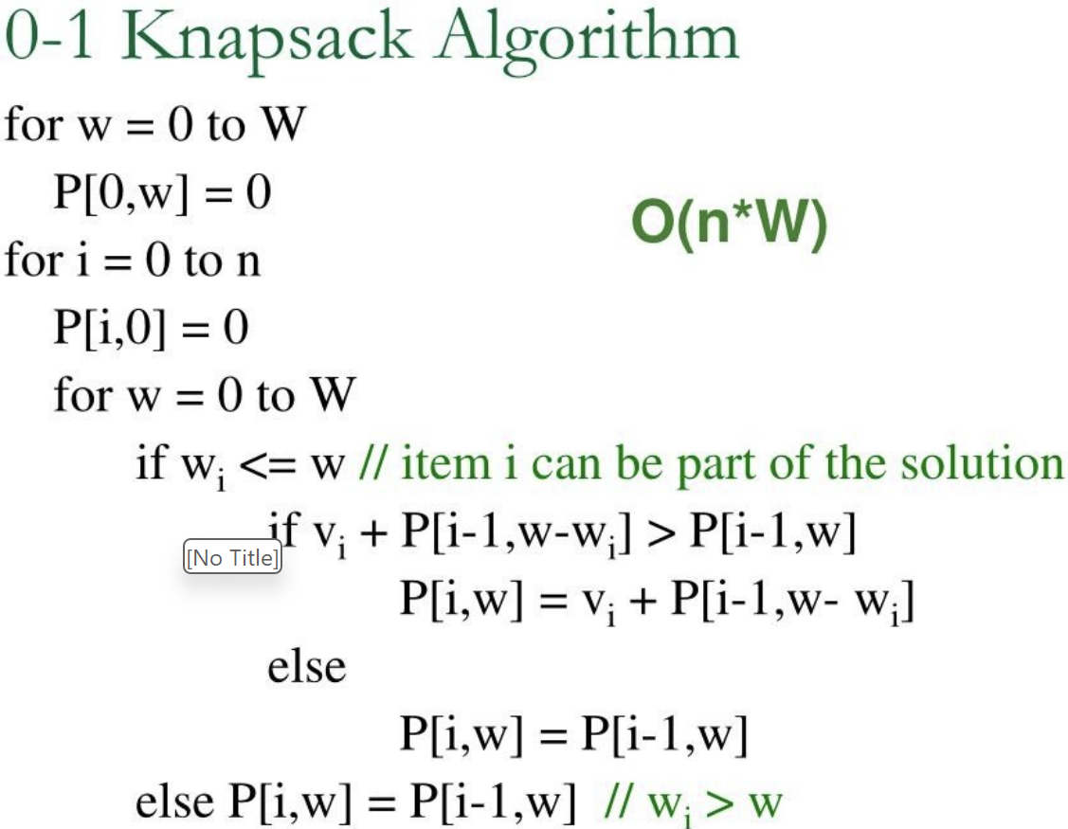

Slide 22
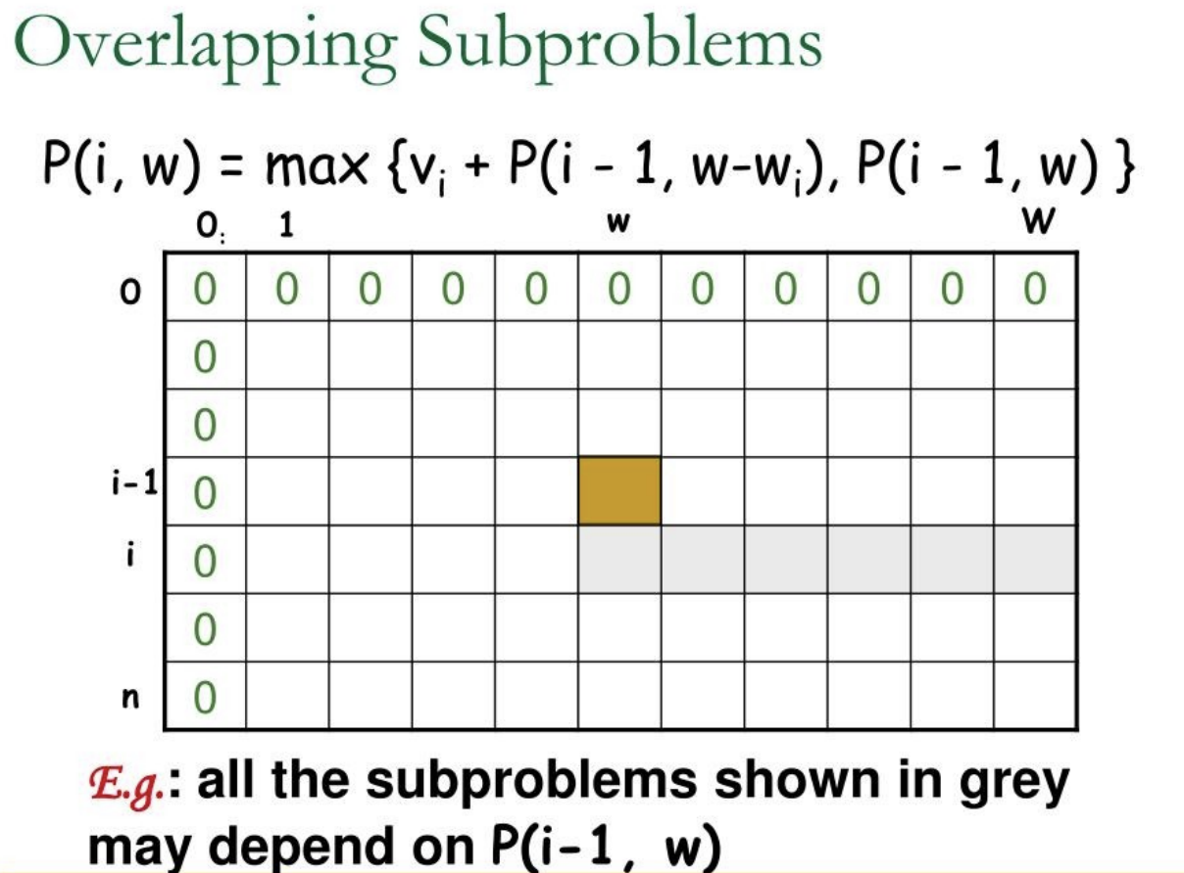

Slide 23
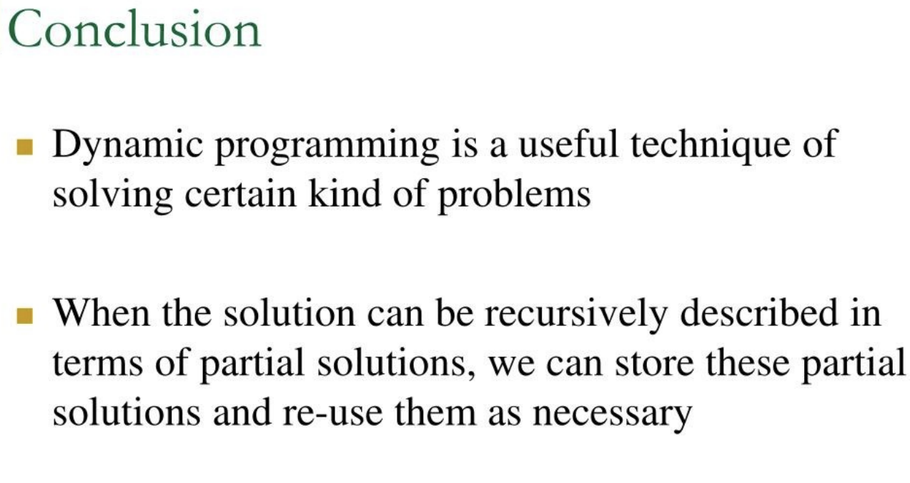

Slide 24
Method 1: Recursion.
To consider all subsets of items, there can be two cases for every item.
knapSack(W, wt, val, n)
Case 1: The item is included in the optimal subset.
Value of nth item plus maximum value obtained by n-1 items and W minus the
weight of the nth item (including nth item)
val[n - 1] + knapSack(W - wt[n - 1], wt, val, n - 1)
Case 2: The item is not included in the optimal set.
Maximum value obtained by n-1 items and W weight (excluding nth item)
knapSack(W, wt, val, n - 1)
Max

Slide 25
function knapsack(n, capacity, weights[], values[]):
// Base case: If no items are left or the capacity is 0, return 0
if n == 0 or capacity == 0:
return 0
// Get the weight and value of the nth item
weight_of_current_item = weights[n-1]
value_of_current_item = values[n-1]
// If the weight of the current item is more than the capacity, we cannot include it
if weight_of_current_item > capacity:
return knapsack(n-1, capacity, weights, values) // Exclude the item and move to the next
else:
// Two choices: include the current item or exclude it
// Choice 1: Include the item
include_item = value_of_current_item + knapsack(n-1, capacity - weight_of_current_item, weights, values)
// Choice 2: Exclude the item
exclude_item = knapsack(n-1, capacity, weights, values)
// Return the maximum value between including and excluding the current item
return max(include_item, exclude_item)

Slide 26
static int knapSack(int W, int wt[], int val[], int n) {
int i, w;
int K[][] = new int[n+1][W+1];
for (i = 0; i <= n; i++) {
for (w = 0; w <= W; w++) {
if (i==0 || w==0)
K[i][w] = 0;
else if (wt[i-1] <= w)
K[i][w] = max(val[i-1] + K[i-1][w-wt[i-1]], K[i-1][w]);
else
K[i][w] = K[i-1][w];
}
}
return K[n][W];
}

Slide 27
https://practice.geeksforgeeks.org/problems/0-1-knapsack-problem/0
https://www.hackerrank.com/contests/srin-aadc03/challenges/classic-01-knapsack/problem

Slide 28
5.4 Edit Distance
One measure of similarity between two strings is their edit distance.
This is a measure of the number of operations required to transform the first string into the other.
Single character operations:
Deletion of a character in the first string
Insertion of a character in the first string
Substitution of a character from the second character into the second string
Match a character in the first string with a character of the second.

Slide 29
Edit Distance
Example from textbook: transform vintner to writers
vintner replace v with w → wintner
wintner insert r after w → wrintner
wrintner match i → wrintner
wrintner delete n → writner
writner match t → writner
writner delete n → writer
writer match e → writer
writer match r → writer
writer insert s → writers

Slide 30
Edit Distance
Defn. An optimal transcript is an edit transcript with the minimal number of edit operations for transforming one string into another.
Note: optimal transcripts may not be unique.
Defn. The edit distance problem entails computing the edit distance between two strings along with an optimal transcript.

Slide 31
5.4: Edit Distance
Input : Two strings str1 and str2
Allowed Operations on str1
Insert
Remove
Replace
Assume operations are of equal cost.
Output : Find minimum number of edits (operations) required to convert ‘str1’ into ‘str2’.

Slide 32
Edit Distance
Input: str1 = "sunday“
str2 = "saturday"
Output: 3
1. Replace 'n' with 'r'
2. Insert t
3. Insert a

Slide 33
Edit Distance
Process all characters one by one staring from either from left or right sides of both strings [Let us process from the right end of the strings]
Let m: Length of str1 (first string)
n: Length of str2 (second string)
If last characters of two strings are same,
recursively calculate the answer for rest of part of the strings
else
(a) perform all three operations to match the last characters, i.e. insert, replace, and remove
(b) recursively calculate the result for the remaining part of the string

Slide 34
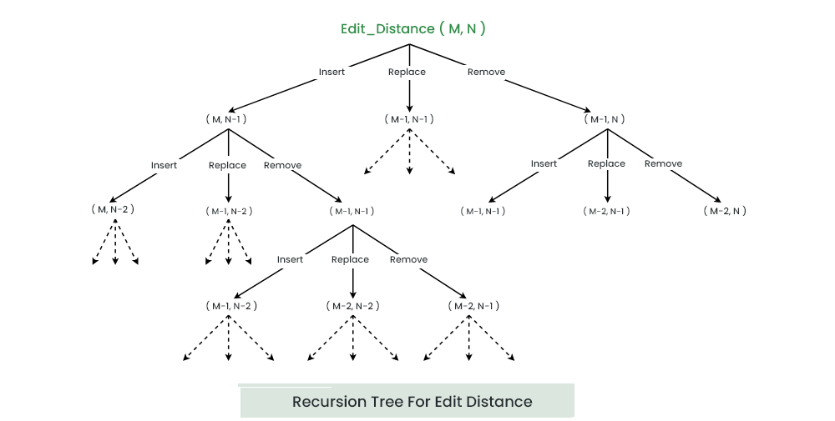

Slide 35
int editDistDP(string str1, string str2, int m, int n)
{
int dp[m+1][n+1];
for (int i=0; i<=m; i++) {
for (int j=0; j<=n; j++) {
if (i==0) // If first string is empty
dp[i][j] = j; // insert all characters of second string, Min. operations = j
else if (j==0) // If second string is empty
dp[i][j] = i; // remove all characters of second string , Min. operations = i
else if (str1[i-1] == str2[j-1])
dp[i][j] = dp[i-1][j-1];
else
dp[i][j] = 1 + min(dp[i][j-1], dp[i-1][j], dp[i-1][j-1]); // Insert, Remove and Replace
}
}
return dp[m][n];
}

Slide 36
Edit Distance to convert CART to MARCH
Str 1 = CART AND Str2 = MARCH
Compare CART to Ø and then MARCH to Ø
 | Ø | M | A | R | C | H
Ø
C
A
R
T

Slide 37
Edit Distance to convert CART to MARCH
Str 1 = CART
Str2 = MARCH
 | Ø | M | A | R | C | H
Ø | 0 | 1 | 2 | 3 | 4 | 5
C | 1 | 1 | 2 | 3 | 3 | 4
A | 2 | 2 | 1 | 2 | 3 | 4
R | 3 | 3 | 2 | 1 | 2 | 3
T | 4 | 4 | 3 | 2 | 2 | 3

Slide 38
https://practice.geeksforgeeks.org/problems/edit-distance3702/1
Or
https://www.hackerrank.com/contests/cse-830-homework-3/challenges/edit-distance

Slide 39
5.5: Longest Increasing Subsequence
longest subsequence of a given sequence such that all elements of the subsequence are sorted in increasing order
For example, for {10, 22, 9, 33, 21, 50, 41, 60, 80}
Subsequence: {10}, {10,22}, {10, 9, 33}, {33, 21, 60}
Increasing Subsequence: {10}, {10,22}, {10, 22, 33}, {33, 50, 60}
Longest Increasing Subsequence: {10, 22, 33, 50, 60, 80} or
{10, 22, 33, 41, 60, 80}
the length of LIS is 6

Slide 40
Longest Increasing Subsequence
Approach 1: Using Brute Force
To find the longest increasing subsequence, the brute force method that comes to our mind is to generate all subsequences and then manually filter the subsequences whose elements come in increasing order and then return the longest such subsequence.
This naive approach will give us the correct answer but to generate all the subsequences, we will require exponential ( 2^{n} ) time.
Therefore, we will try some other approaches.

Slide 41
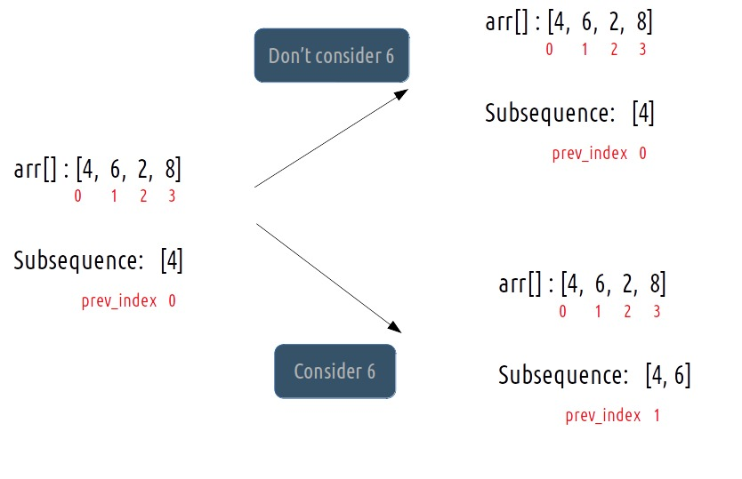
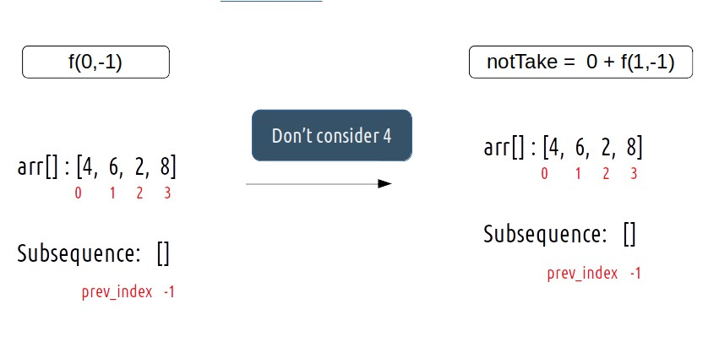
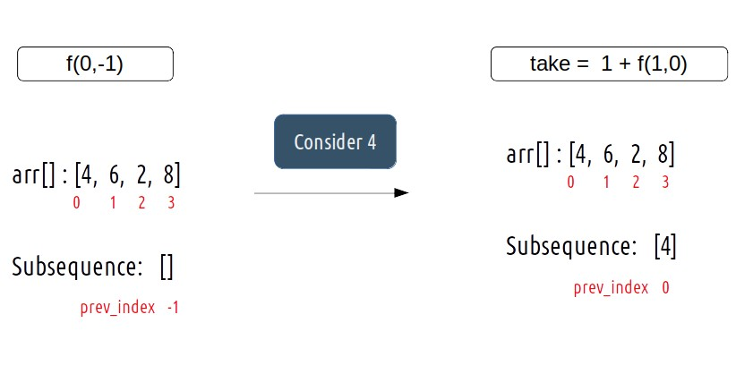
Approach 2: Using Dynamic Programming
Steps to form the recursive solution:
Step 1: Express the problem in terms of indexes.
Step 2: Explore all possibilities at a given index
f(ind, prev_index)
{
notTake = 0 + f(ind + 1, prev_index)
if(prev_index == -1 || arr[ind]>arr[prev_index])
{ take = 1 + f(ind + 1, ind) }
}

Slide 42
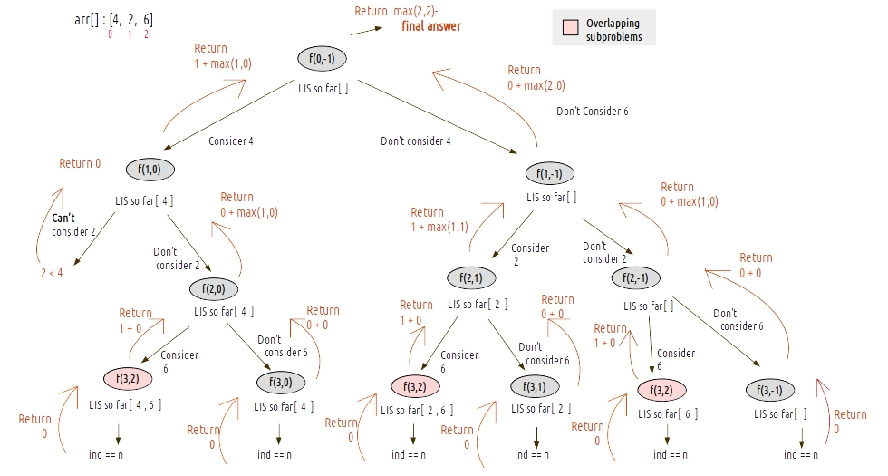
f(ind, prev_index){
if(ind == n) return 0
notTake = 0 + f(ind + 1, prev_index)
if(prev_index == -1 || arr[ind]>arr[prev_index]) { take = 1 + f(ind + 1, ind) }
return max(notTake, take)
}

Slide 43
https://practice.geeksforgeeks.org/problems/longest-common-increasing-subsequence1437/1

Slide 44
5.6: Longest Common Subsequence
Given two sequences, the length of longest subsequence present in both of them.
A subsequence is a sequence that appears in the same relative order, but not necessarily contiguous.
For example, “abc”, “abg”, “bdf”, “aeg”, ‘”acefg”, .. etc are subsequence of “abcdefg”.
LCS for input Sequences “ABCDGH” and “AEDFHR” is “ADH” of length 3.
LCS for input Sequences “AGGTAB” and “GXTXAYB” is “GTAB” of length 4.
A string of length n has 2^{n} different possible subsequence.

Slide 45
Longest Common Subsequence
Let the input sequences be X[m] and Y[n] of lengths m and n respectively
Let L(X[m], Y[n]) be the length of LCS of the two sequences X and Y
If last characters of both sequences match (or X[m-1] == Y[n-1]) then
L(X[0..m-1], Y[0..n-1]) = 1 + L(X[0..m-2], Y[0..n-2])
e.g. L(“AGGTAB”, “GXTXAYB”) = 1 + L(“AGGTA”, “GXTXAY”)
If last characters of both sequences do not match (or X[m-1] != Y[n-1]) then
L(X[0..m-1], Y[0..n-1]) = MAX ( L(X[0..m-2], Y[0..n-1]), L(X[0..m-1], Y[0..n-2]) )
e.g. L(“ABCDGH”, “AEDFHR”) = MAX( L(“ABCDG”, “AEDFHR”), L(“ABCDGH”, “AEDFH”) )

Slide 46
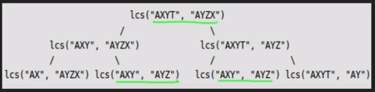

Slide 47
L(“AGGTAB”, “GXTXAYB”)
 | NULL | A | G | G | T | A | B
NULL |  | 0 | 0 | 0 | 0 | 0 | 0
G | 0
X | 0
T | 0
X | 0
A | 0
Y | 0
B | 0

Slide 48
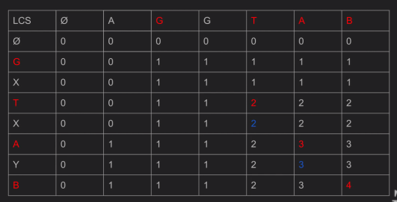

Slide 49
int lcs( char *X, char *Y, int m, int n )
{
int L[m+1][n+1];
int i, j;
for (i=0; i<=m; i++)
{
for (j=0; j<=n; j++)
{
if (i == 0 || j == 0)
L[i][j] = 0;
else if (X[i-1] == Y[j-1])
L[i][j] = L[i-1][j-1] + 1;
else
L[i][j] = max(L[i-1][j], L[i][j-1]);
}
} return L[m][n];
}

Slide 50
https://practice.geeksforgeeks.org/problems/longest-common-subsequence/0
https://www.hackerrank.com/challenges/dynamic-programming-classics-the-longest-common-subsequence/problem
https://practice.geeksforgeeks.org/problems/print-all-lcs-sequences3413/1
https://practice.geeksforgeeks.org/problems/reach-a-given-score/0/?category[]=Dynamic%20Programming&page=1&query=category[]Dynamic%20Programmingpage1
https://practice.geeksforgeeks.org/problems/count-all-possible-paths-from-top-left-to-bottom-right/0/?category[]=Dynamic%20Programming&difficulty[]=0&page=2&query=category[]Dynamic%20Programmingdifficulty[]0page2
https://practice.geeksforgeeks.org/problems/bell-numbers/0

Slide 51
https://www.hackerrank.com/challenges/coin-change
https://www.hackerrank.com/challenges/maxsubarray
https://www.hackerrank.com/challenges/xor-and-sum
https://www.hackerrank.com/challenges/red-john-is-back
https://www.hackerrank.com/challenges/play-game

Slide 52
1. Check if any valid sequence is divisible by M
https://practice.geeksforgeeks.org/problems/check-if-any-valid-sequence-is-divisible-by-m/0
2. LCS of '0' K Repeated String
https://practice.geeksforgeeks.org/problems/lcs-of-0-k-repeated-string/0
3. Minimum number of deletions and insertions
https://practice.geeksforgeeks.org/problems/minimum-number-of-deletions-and-insertions0209/1
4. Minimum insertions to sort an array
https://practice.geeksforgeeks.org/problems/minimum-insertions-to-sort-an-array0535/1
5. Minimum steps to delete a string
https://practice.geeksforgeeks.org/problems/minimum-steps-to-delete-a-string2956/1
6. Subset with sum divisible by m
https://practice.geeksforgeeks.org/problems/subset-with-sum-divisible-by-m2546/1
7. Count of strings that can be formed using a, b and c under given constraints
https://practice.geeksforgeeks.org/problems/count-of-strings-that-can-be-formed-using-a-b-and-c-under-given-constraints/0

Slide 53
8. Shortest Uncommon Subsequence
https://practice.geeksforgeeks.org/problems/shortest-uncommon-subsequence/0
9. Size of array after repeated deletion of LIS
https://practice.geeksforgeeks.org/problems/size-of-array-after-repeated-deletion-of-lis/0
10. Find number of times a string occurs as a subsequence
https://practice.geeksforgeeks.org/problems/find-number-of-times-a-string-occurs-as-a-subsequence3020/1
11. Printing Maximum Sum Increasing Subsequence
https://practice.geeksforgeeks.org/problems/maximum-sum-increasing-subsequence4749/1
12. Count Increasing Subsequence
https://practice.geeksforgeeks.org/problems/count-increasing-subsequences/0
13. Pairs with specific difference
https://practice.geeksforgeeks.org/problems/pairs-with-specific-difference/0
14. Minimum number of Coins
https://practice.geeksforgeeks.org/problems/number-of-coins1824/1

Slide 54
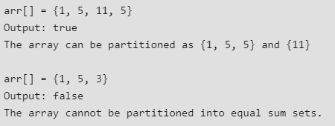
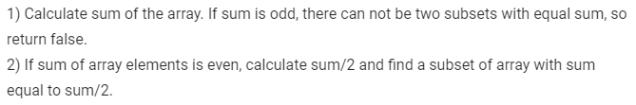
5.7: Partition Problem

Slide 55
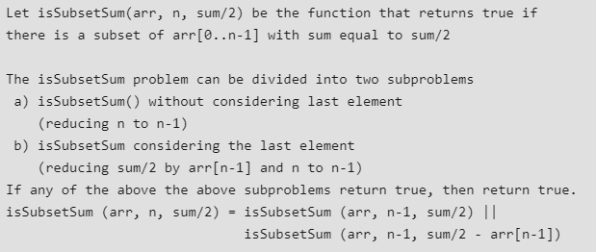

Slide 56

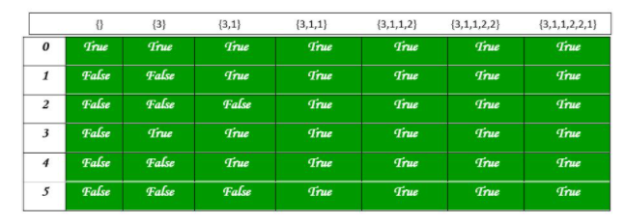

Slide 57
static boolean findPartition(int arr[], int n){
int sum = 0; int i, j;
for (i = 0; i < n; i++)
sum += arr[i];
if (sum % 2 != 0)
return false;
boolean part[][] = new boolean[sum / 2 + 1][n + 1];
for (i = 0; i <= n; i++)
part[0][i] = true;
for (i = 1; i <= sum / 2; i++)
part[i][0] = false;
for (i = 1; i <= sum / 2; i++) {
for (j = 1; j <= n; j++) {
part[i][j] = part[i][j - 1];
if (i >= arr[j - 1])
part[i][j] = part[i][j] || part[i - arr[j - 1]][j - 1];
}
}
return part[sum / 2][n];
}

Slide 58
https://practice.geeksforgeeks.org/problems/subset-sum-problem2014/1
https://practice.geeksforgeeks.org/problems/minimum-sum-partition3317/1

Slide 59
Extra

Slide 60
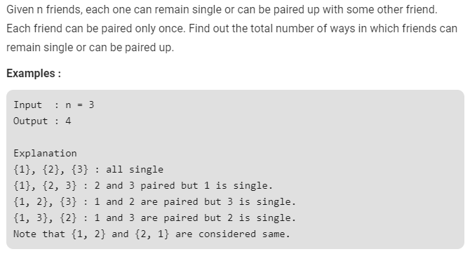
Friends Pairing Problem

Slide 61
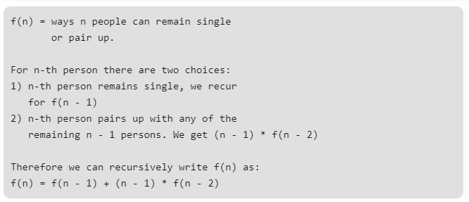
Friends Pairing Problem
https://practice.geeksforgeeks.org/problems/friends-pairing-problem5425/1#:~:text=If%20you%20are%20facing%20any,please%20click%20to%20join%20directly.&text=Given%20N%20friends%2C%20each%20one,or%20can%20be%20paired%20up.

